Slide 1

C Programming tutorial
By Aman Tiwari

Slide 2
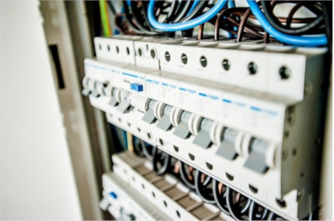
What is a Programming Language
A programming language is a set of instructions that can be used to interact with and control a computer. These languages are used to design websites, create apps, develop operating systems, control spacecraft, and analyze data. Programming languages are necessary because computers can't understand English. Programming languages bridge this gap by helping programmers translate their commands into something that the computer can understand and execute.
Computers are made of many tiny switches that can be either on or off.
When a switch is on, it is represented by a 1. When it is off, it is represented by a 0.
These 1s and 0s are called bits. Bits are the fundamental language of nearly all
computers and every program must be translated into bits before it can be
executed by the computer. When 8 bits are grouped together, this is called a byte.
A byte can represent a letter, for example, 01100001 represents 'a'.

Slide 3
Types of Programming Languages
There are three types of programming languages: machine language, assembly language, and high-level language.
Low-Level Languages:
Characteristics:
Close to Hardware: Provide minimal abstraction from the hardware.
Efficient: Programs can be highly optimized for performance.
Difficult to Write: Requires detailed knowledge of the computer’s architecture.
Fast Execution: Directly executed by the CPU or with minimal translation.
Examples:
Machine Language: Binary code specific to a computer’s CPU.
Assembly Language: Uses mnemonics and symbols to represent machine language instructions.
Use Cases:
Writing operating systems, device drivers, and embedded systems where performance and control are critical.

Slide 4
Mid-Level Languages:
Characteristics:
Balance of Abstraction: Offers a balance between low-level hardware control and high-level programming constructs.
Access to Hardware: Provides facilities for direct hardware manipulation.
Readable: Easier to read and write than low-level languages but allows efficient and performant code.
Examples:
C: Combines high-level constructs with low-level hardware manipulation capabilities.
C++: Extends C with object-oriented features while retaining low-level capabilities.
Use Cases:
System programming, game development, real-time computing, and applications requiring performance optimizations.

Slide 5
High-Level Languages:
Characteristics:
Easy to Write: Focus on ease of use, readability, and developer productivity.
Portability: Programs can run on different hardware platforms with little to no modification.
Rich Libraries and Tools: Often come with extensive standard libraries and tools to speed up development.
Examples:
Python: Known for its readability and simplicity.
Java: Object-oriented and designed for portability across platforms.
Ruby: Emphasizes simplicity and productivity.
JavaScript: Widely used for web development.
Swift: Designed for iOS and macOS development, known for its modern syntax and safety features.
Use Cases:
Web development, desktop applications, mobile applications, data science, machine learning, and automation.
Some newer high-level languages are scripting languages. This means that they are not compiled, or translated into machine language, until just before the code is executed at runtime. Python, Javascript, PHP, Ruby, and Bash are all scripting languages.

Slide 6
Programming Languages
Low level | Mid Level | High Level
They are machine dependent which directly access the machine resources using bits , CPU registors, pointers,etc | It is machine independent and it contains 50% features of low level and 50% Features of high level. Eg. C & C++ | They are platform (hardware+software) independent and they Follows another methodology like OOPs (object oriented programming ). Eg. Java ,python,C# etc

Slide 7
Environment setup
C code
(English)
Desktop
(Binary 0 1 )
Compiler
Text Editor :- Compiler :- Device (Terminal) :-
Eg. Notepad,Notepad++, GCC (GNU compiler command prompt,
Sublime,atom,brackets, collection) ,bcc,MinGW, powershell,Terminal
Vs code etc. https://www.onlinegdb.com/ etc.
,other online compiler,etc.

Slide 8
IDE : Integrated Development Environment ( ide = text editor + compiler + terminal + intellisence etc)
Eg. Turbo C/C++ ,code blocks, dev c/c++ , eclipse ,visual studio ( > 20 GB ) etc.
My Combination : VS code + GCC + powershell /cmd
For Begginers : dev c/c++ ,code blocks
https://jmeubank.github.io/tdm-gcc/download/
https://code.visualstudio.com/download
https://sourceforge.net/projects/dev-cpp/files/Binaries/Dev-C%2B%2B%204.9.9.2/devcpp-4.9.9.2_setup.exe/download
https://sourceforge.net/projects/codeblocks/files/latest/download

Slide 9
History of C language is interesting to know. Here we are going to discuss a brief history of the c language.
C programming language was developed in 1971 by Dennis Ritchie at bell laboratories of AT&T (American Telephone & Telegraph), located in the U.S.A.
Dennis Ritchie is known as the founder of the c language.

Slide 10
What is C and Why C ?
The C Language is developed for creating system applications that directly interact with the hardware devices such as drivers, kernels, etc.
It provides feasible interaction with hardware devices without compromising on the performance.
C programming is considered as the base for other programming languages, that is why it is also known as mother language.
It can be defined by the following ways:
Mother language
System programming language
Procedure-oriented programming language
Structured programming language
Mid-level programming language

Slide 11
C as a mother language
C language is considered as the mother language of all the modern programming languages because most of the compilers, JVMs, Kernels, etc. are written in C language, and most of the programming languages follow C syntax, for example, C++, Java, C#, etc.
2) C as a system programming language
A system programming language is used to create system software. C language is a system programming language because it can be used to do low-level programming (for example driver and kernel). It is generally used to create hardware devices, OS, drivers, kernels, etc. For example, Linux kernel is written in C.

Slide 12
3) C as a procedural language
A procedure is known as a function, method, routine, subroutine, etc. A procedural language specifies a series of steps for the program to solve the problem.
A procedural language breaks the program into functions, data structures, etc.
C is a procedural language. In C, variables and function prototypes must be declared before being used.
4) C as a structured programming language
A structured programming language is a subset of the procedural language. Structure means to break a program into parts or blocks so that it may be easy to understand.
In the C language, we break the program into parts using functions. It makes the program easier to understand and modify.

Slide 13
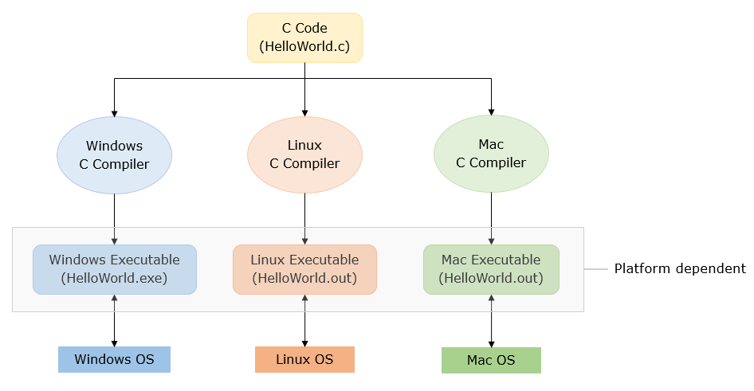
Why c is Machine dependent
Sometimes, it means the same as "hardware dependent" or "machine dependent" and refers to applications that run in only one hardware series with the operating system not being relevant. In contrast, "platform independent" means that the application can run in different operating environments.

Slide 14
Let’s Start with C
Steps in learning English language:
Alphabets
Words
Sentences
Paragraphs
Steps in learning C:
Alphabets
Digits
Special
symbols
Constants
Variables
Keywords
Instructions
Program

Slide 15
C Keywords
Keywords represents words whose meaning have been already explained to the C Compiler.
Keywords cannot be used as variable names.
Keywords are also called ‘Reserved words’.
32 keywords available in C are:
auto | double | int | struct
break | else | long | switch
case | enum | register | typedef
char | extern | return | union
cont | float | short | unsigned
continue | for | signed | void
default | goto | sizeof | volatile
do | if | static | while

Slide 16
Basic Structure of C Program In modern Compilers
#include <stdio.h>
int main()
{
printf("Hello in C Programming");
return 0;
}
// standard input output header file (stdio) or preprocessor directives
// Starting point of a program or main function
// Starting body of main function
// Printing output on terminal
// Semicolon(;) means end of line or statement(instruction)
// Ending point of a program
// Ending of body

Slide 17
Basic Structure of C Program In Turbo C/C++
#include <stdio.h>
#include<conio.h>
int main()
{
clrscr();
printf("Hello C Programming\n");
getch();
return 0;
}

Slide 18
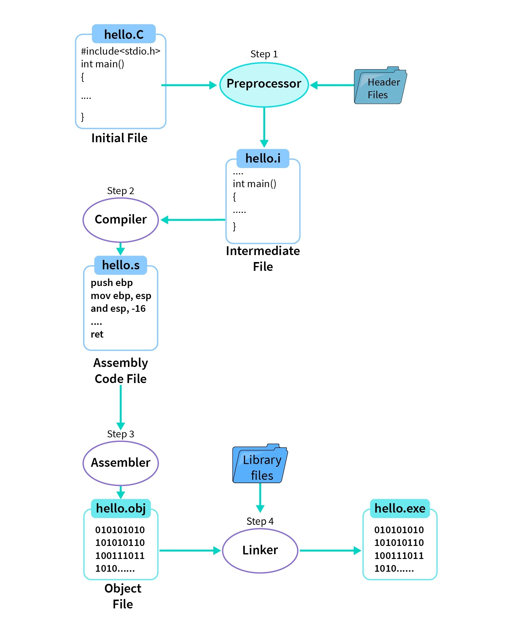

Slide 19
Preprocessing
What Happens:The preprocessor processes the C source code (hello.c) before actual compilation.
It handles directives like #include (which includes header files) and #define (which defines macros).
Output:An intermediate file (hello.i) with all the header files included and macros expanded.
2. Compilation
What Happens:The compiler translates the preprocessed code (hello.i) into assembly language.
Output:An assembly file (hello.s) containing human-readable assembly instructions.
3. Assembly
What Happens:The assembler converts assembly code (hello.s) into machine code, creating an object file.
Output:An object file(hello.o) with binary code that CPU can understand, but it's not yet a complete program.
4. Linking
What Happens:The linker takes the object file (hello.o) and links it with necessary libraries (like the standard C library) to resolve all function calls and create the final executable.
Output:An executable file (hello.exe or just hello on Unix systems) that you can run on your computer.

Slide 20
Understanding Header Files and Libraries
Header Files:
Purpose: Provide declarations for functions, macros, constants, and data types.
Example: #include <stdio.h> includes the declarations for standard input/output functions like printf() and scanf().
Libraries:
Purpose: Provide the actual implementations of the functions declared in the header files.
Types:
Standard Libraries: Included with the compiler (e.g., the C Standard Library).
Third-Party Libraries: Provided by external sources for additional functionality.

Slide 21

Thank You
AMANTIWARI8861@GMAIL.COM

